Slide 1
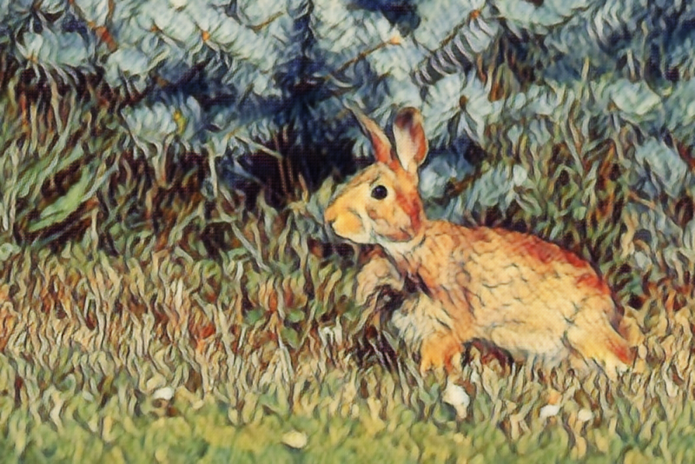
Edge, Patch, AI Art
A Journey of Theory, Code, Videos and Tons of Images!

Slide 2
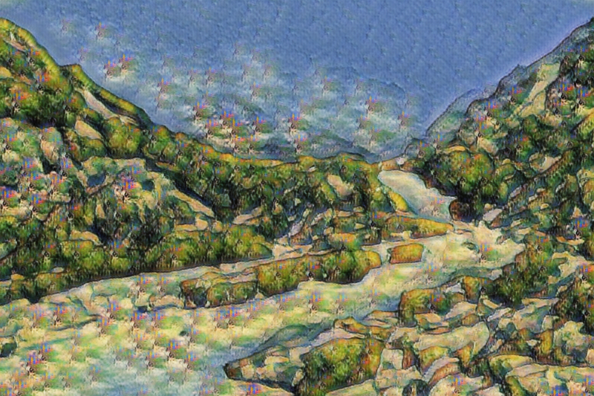
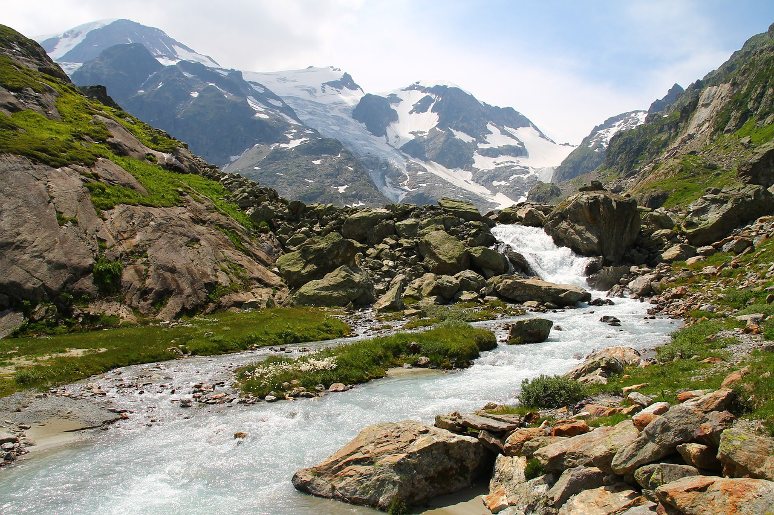
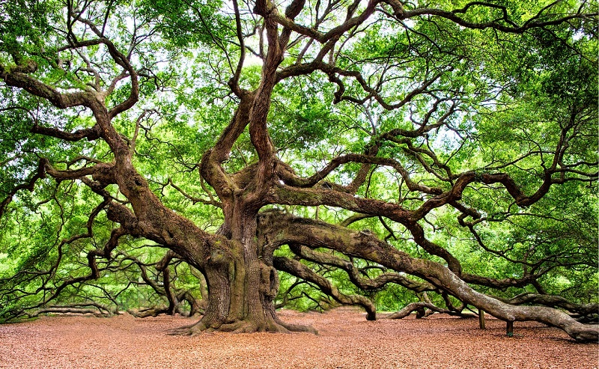
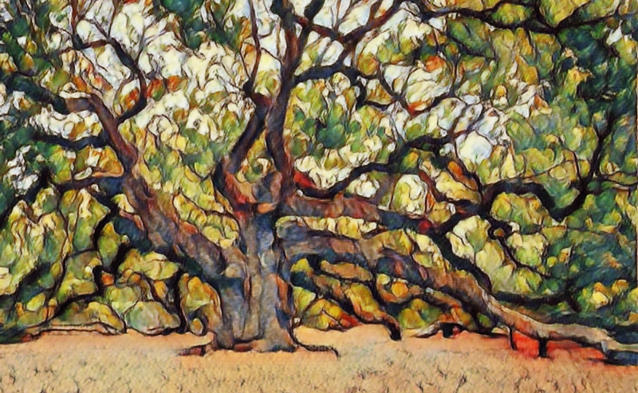
Outline
Problem Statement
GAN Basics
Regularization
Feature Loss
Edge Loss
Identity Loss
Model Architectures
Conclusions
References

Slide 3
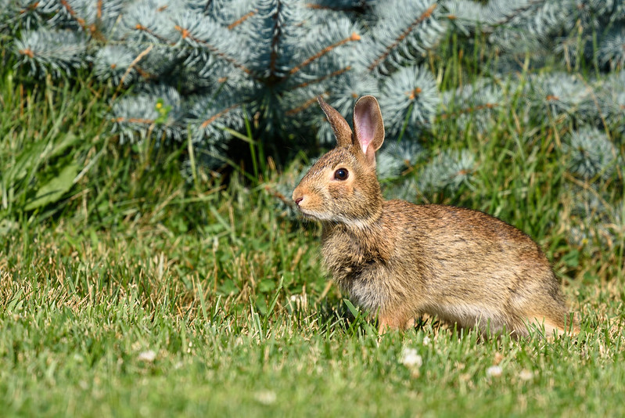
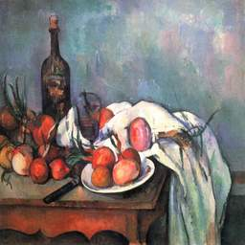
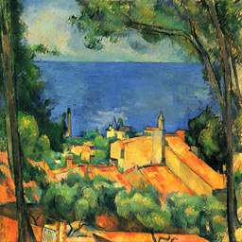
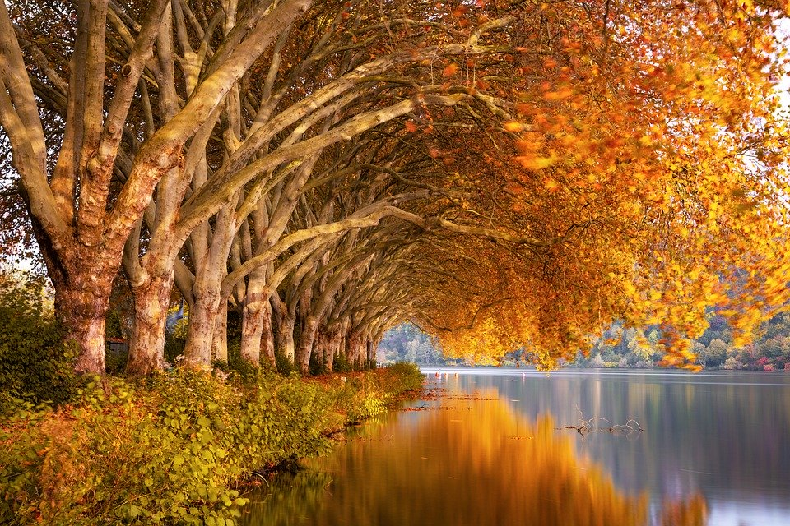
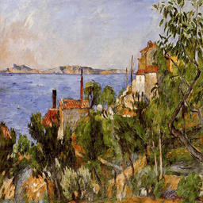
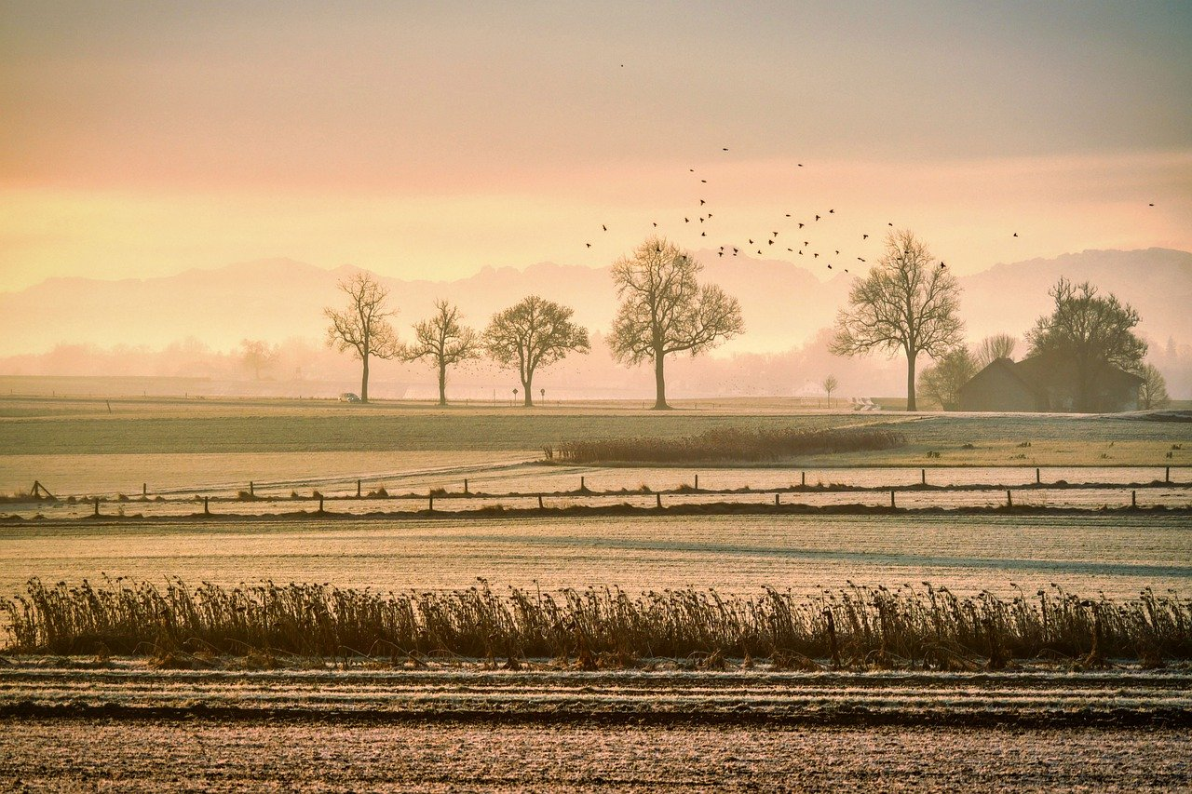
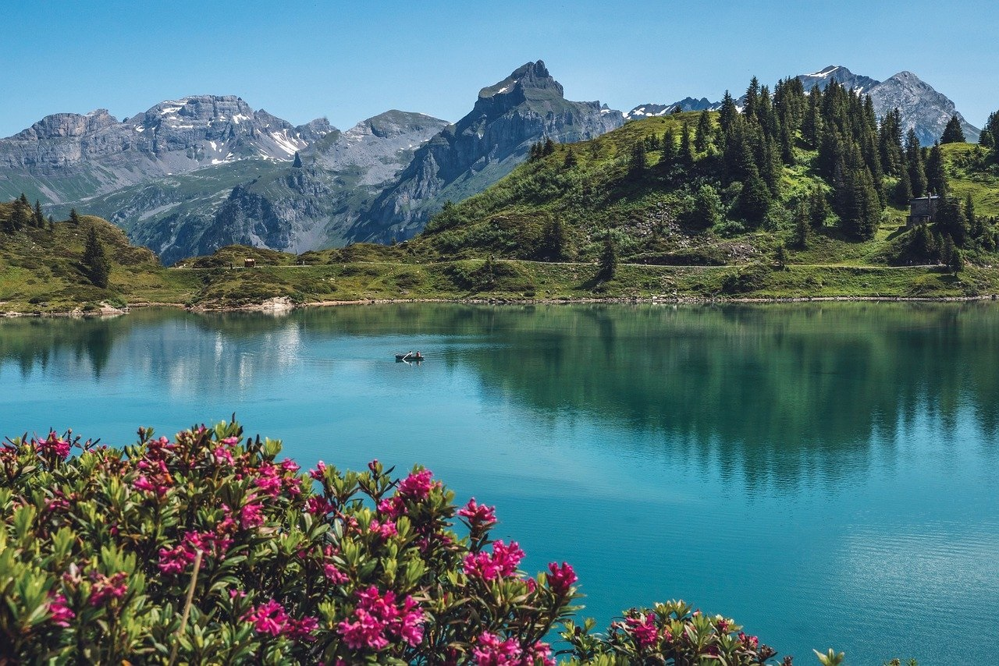
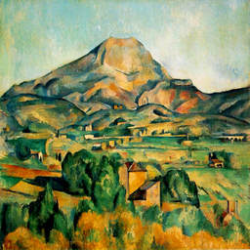
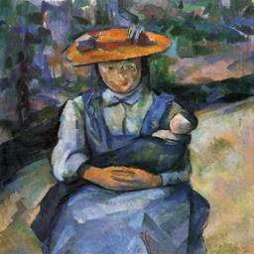
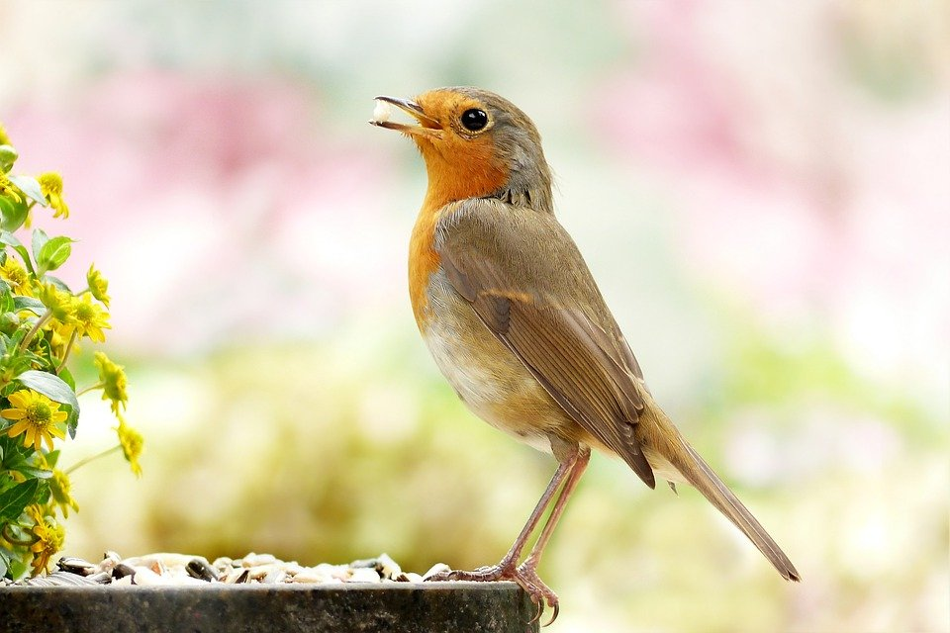
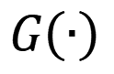
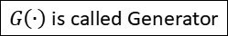
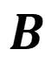
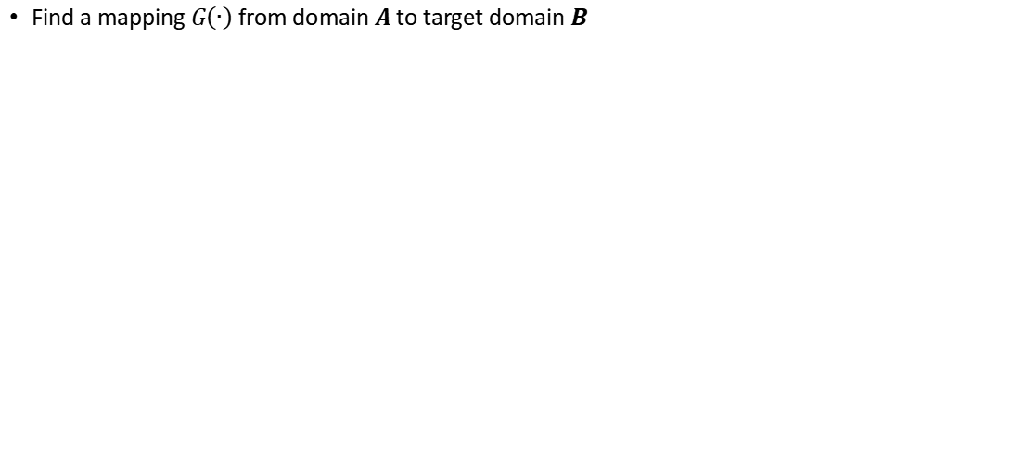
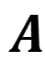
Problem Statement
$G\left(∙\right)$ is called Generator
Paul Cezanne was a 19th century
post-impressionistic French painter
Find a mapping $G\left(∙\right)$ from domain $A$ to target domain $B$
$$A$$
$$B$$
$$G\left(∙\right)$$
Paintings created (and could have created) by Cezanne
Photos

Slide 4
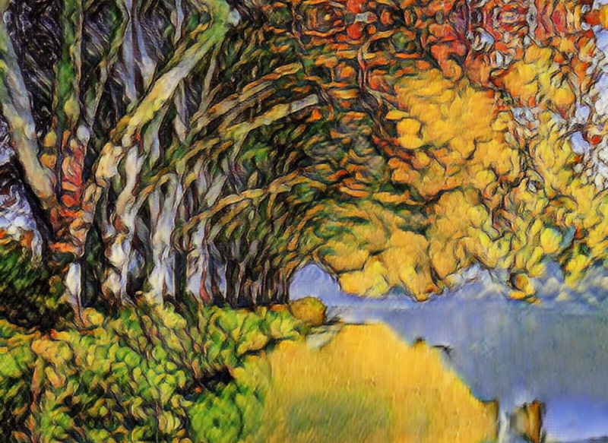
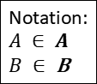
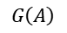
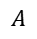

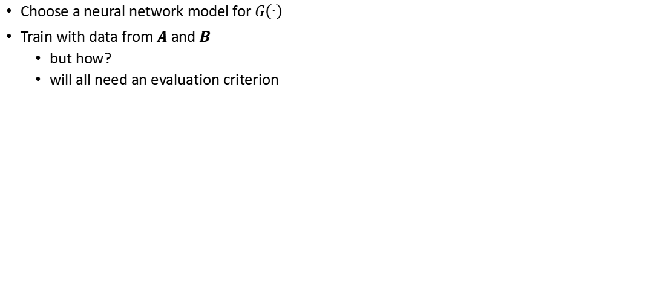
A Deep Learning Approach
Choose a neural network model for $G\left(∙\right)$
Train with data from $A$ and $B$
but how?
will all need an evaluation criterion
Notation:
$$A ∈ A$$
$B ∈$B
$$A$$
$$G\left(A\right)$$
$$G\left(∙\right)$$

Slide 5
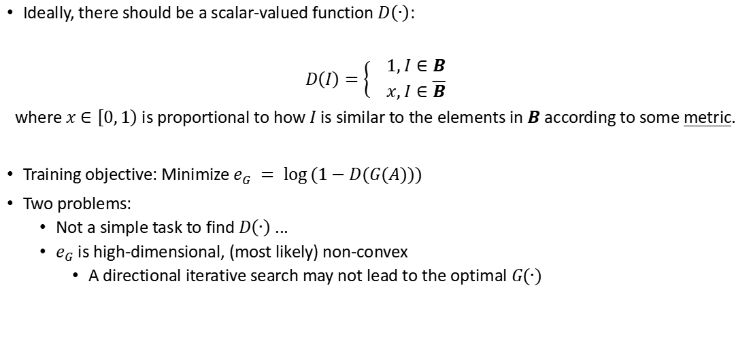

How to evaluate $G\left(∙\right)$?
Ideally, there should be a scalar-valued function $D\left(∙\right)$:
$D\left(I\right)=\left\{\begin{aligned} 1, I∈B \\ x, I∈\overline{B}\end{aligned}\right.$
where $x∈\left[0,\left.1\right)\right.$ is proportional to how $I$ is similar to the elements in $B$ according to some metric.
Training objective: Minimize $e_{G} = \log{(1−D(G(A)))}$
Two problems:
Not a simple task to find $D\left(∙\right)$ ...
$e_{G}$ is high-dimensional, (most likely) non-convex
A directional iterative search may not lead to the optimal $G(∙)$

Slide 6
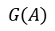
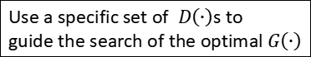
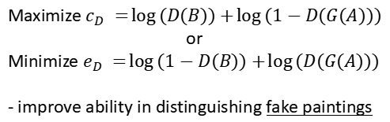
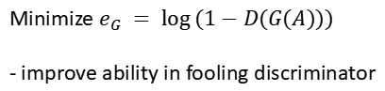
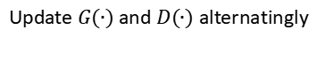
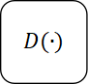
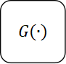
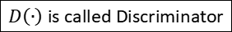
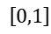
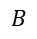
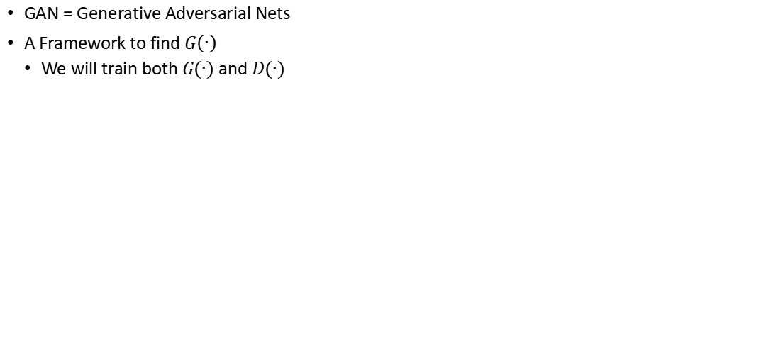
GAN Basics
Use a specific set of $D\left(∙\right)$s to
guide the search of the optimal $G\left(∙\right)$
GAN = Generative Adversarial Nets
A Framework to find $G\left(∙\right)$
We will train both $G(∙)$ and $D(∙)$
$D\left(∙\right)$ is called Discriminator
Update $G(∙)$ and $D(∙)$ alternatingly
$$G(∙)$$
$$B$$
$$D(∙)$$
$$A$$
$$G(A)$$
Iterate
$$\left[0,1\right]$$
$$G(A)$$
Minimize $e_{G} = \log{(1−D(G(A)))}$
- improve ability in fooling discriminator
Maximize $c_{D} =\log\left(D(B)\right)+\log{(1−D(G(A)))}$
or
Minimize $e_{D} =\log\left(1−D(B)\right)+\log{(D(G(A)))}$
- improve ability in distinguishing fake paintings

Slide 7
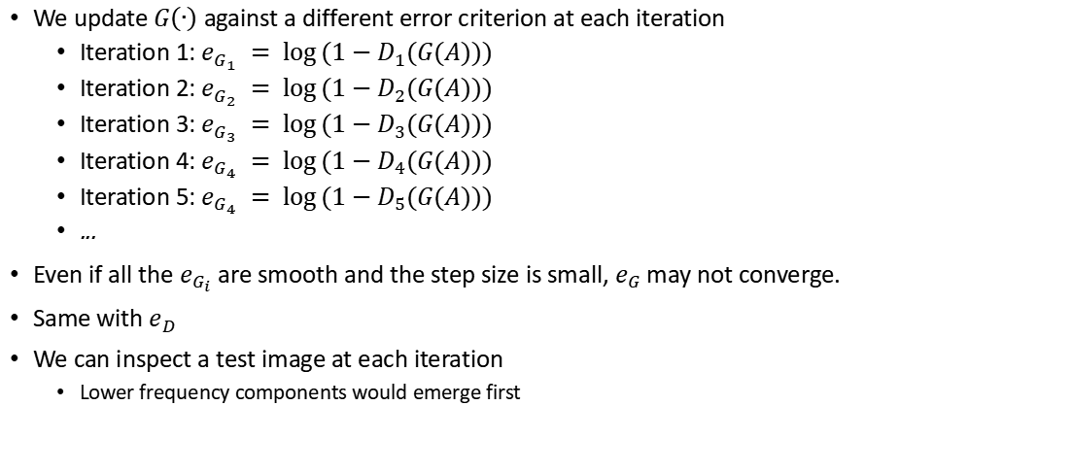
Convergence?
We update $G\left(∙\right)$ against a different error criterion at each iteration
Iteration 1: $e_{G_{1}} = \log{(1−D_{1}(G(A)))}$
Iteration 2: $e_{G_{2}} = \log{(1−D_{2}(G(A)))}$
Iteration 3: $e_{G_{3}} = \log{(1−D_{3}(G(A)))}$
Iteration 4: $e_{G_{4}} = \log{(1−D_{4}(G(A)))}$
Iteration 5: $e_{G_{4}} = \log{(1−D_{5}(G(A)))}$
...
Even if all the $e_{G_{i}}$ are smooth and the step size is small, $e_{G}$ may not converge.
Same with $e_{D}$
We can inspect a test image at each iteration
Lower frequency components would emerge first

Slide 8
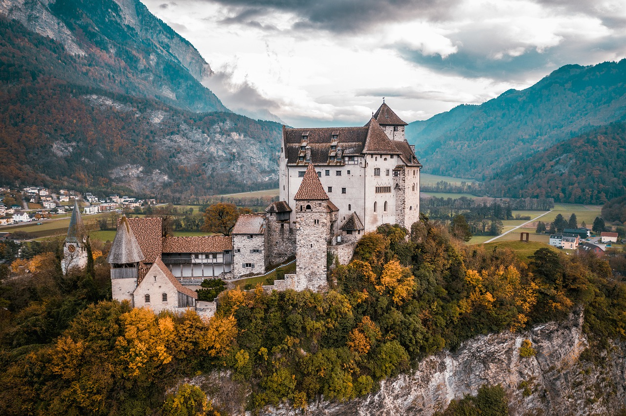
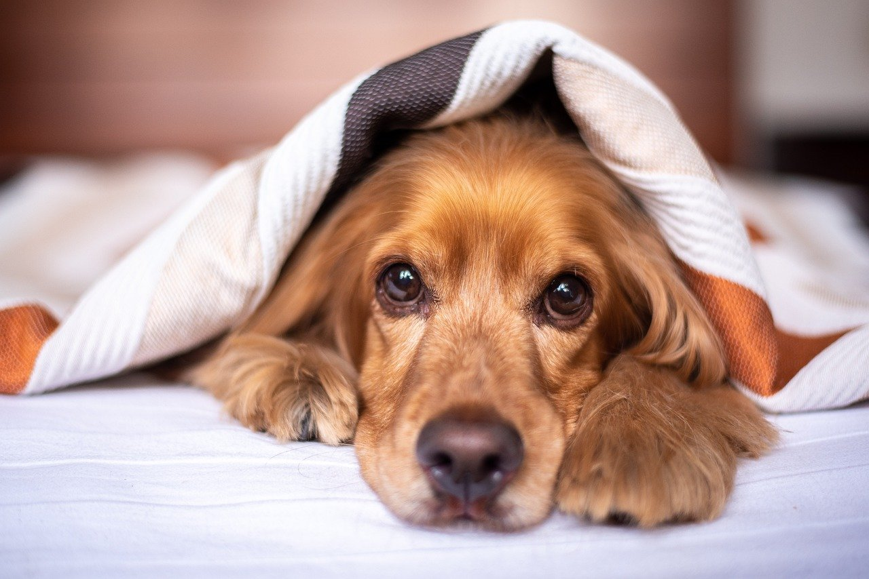
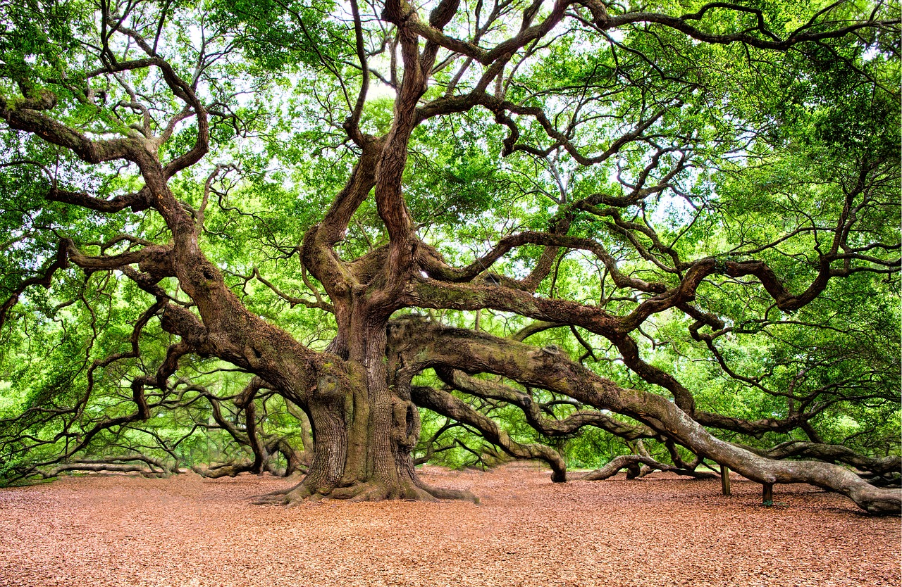
Benchmark Images

Slide 9
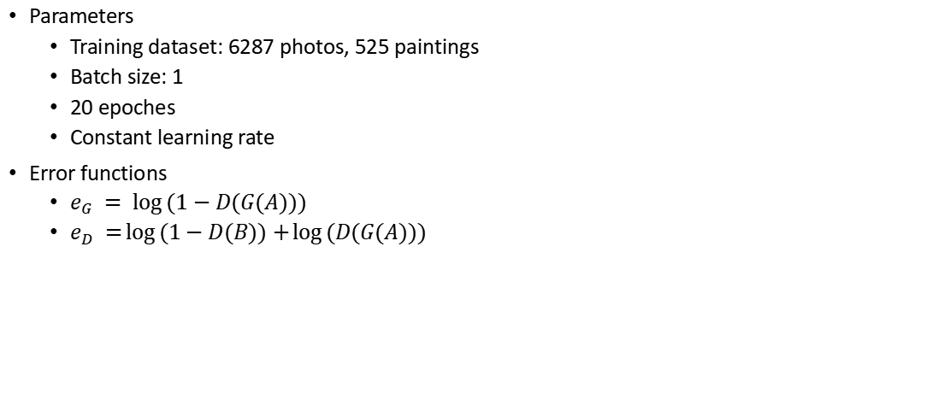
Training Parameters
Parameters
Training dataset: 6287 photos, 525 paintings
Batch size: 1
20 epoches
Constant learning rate
Error functions
$e_{G} = \log{(1−D(G(A)))}$
$e_{D} =\log\left(1−D(B)\right)+\log{(D(G(A)))}$

Slide 10
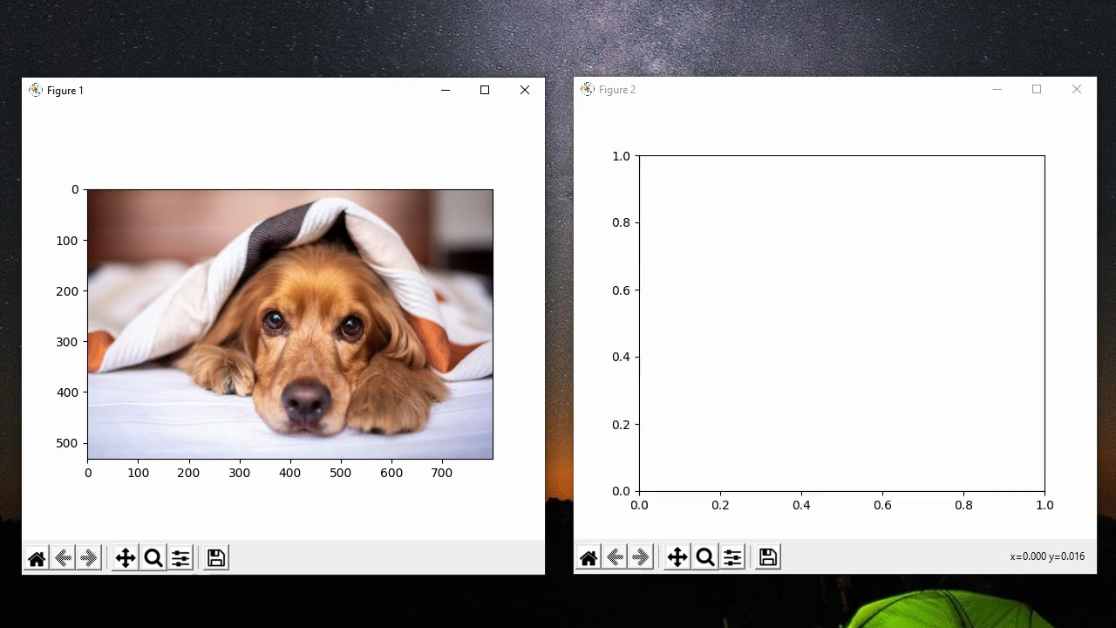
Videos

Slide 11
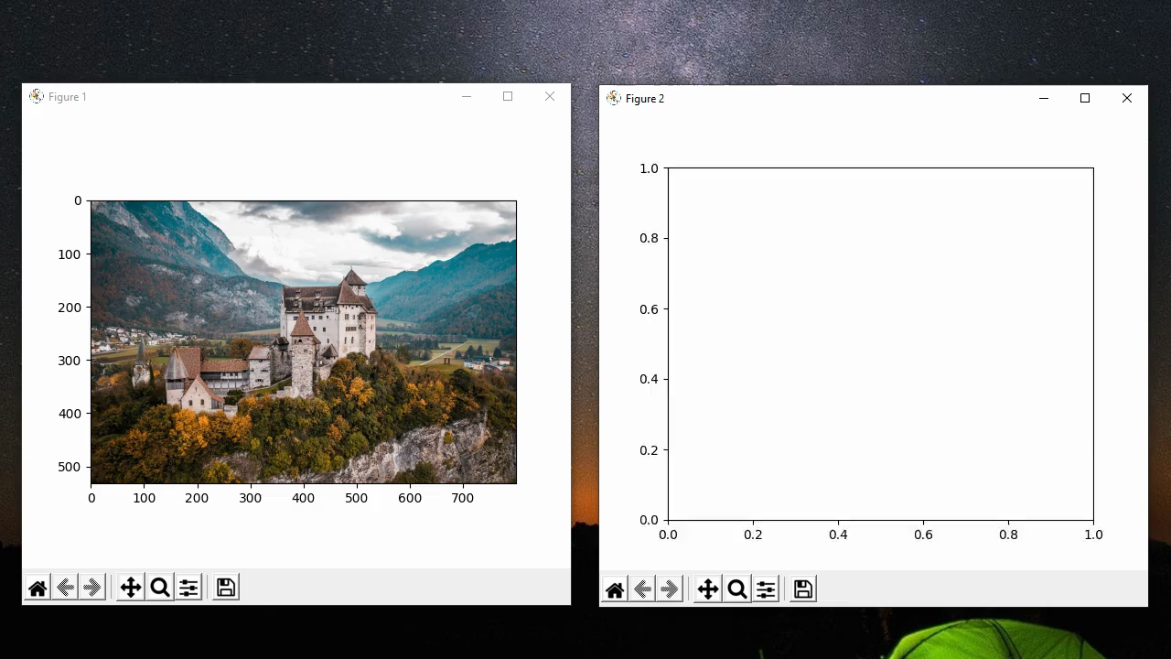
Videos

Slide 12
Outline
Problem Statement
GAN Basics
Regularization
Feature Loss
Edge Loss
Identity Loss
Model Architecture
Conclusions
References

Slide 13
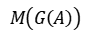
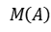
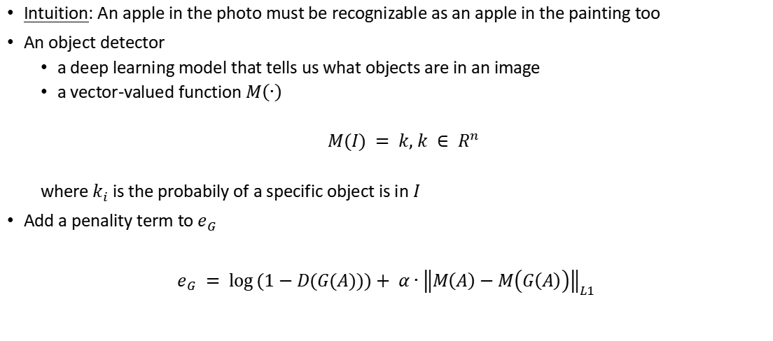
Feature Loss
Intuition: An apple in the photo must be recognizable as an apple in the painting too
An object detector
a deep learning model that tells us what objects are in an image
a vector-valued function $M\left(∙\right)$
$M(I) = k, k ∈ R^{n}$
where $k_{i}$ is the probabily of a specific object is in $I$
Add a penality term to $e_{G}$
$e_{G} = \log{(1−D(G(A)))}+ α∙{\left\|M\left(A\right)−M\left(G\left(A\right)\right)\right\|}_{L1}$
$$M\left(A\right)$$
$$M\left(G\left(A\right)\right)$$

Slide 14
Code
Let’s test our the intuition with a ResNet-50 object detector
http://localhost:8888/lab/tree/cGAN/henri/Test_Resnet_object_detection.ipynb

Slide 15
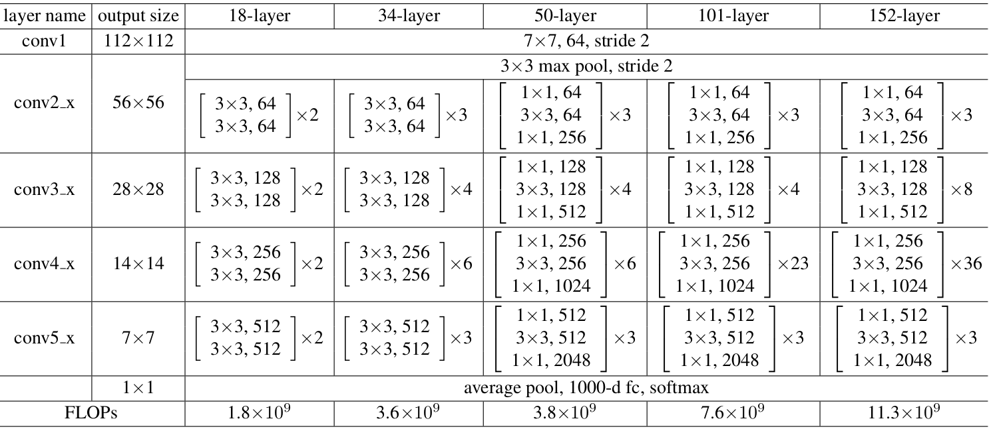
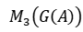
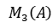





ResNet-50
$$M_{3}\left(A\right)$$
$$M_{3}\left(G\left(A\right)\right)$$
$$M_{2}\left(A\right)$$
$$M_{2}\left(G\left(A\right)\right)$$
Use ResNet-50 pretrained on ImageNet as an object detector
Last feature map-> 7x7x2048
$$M_{3}(I)$$
Average pooling -> 1x2048
$$M_{2}(I)$$
Fully connected layer -> 1x1000
(weighted sum)
$$M_{1}(I)$$

Slide 16

Training Parameters
Parameters
Training dataset: 6287 photos, 525 paintings
Batch size: 1
20 epoches
Constant learning rate
Error functions
$e_{G} = \log{(1−D(G(A)))}+ α∙{\left\|M_{1}\left(A\right)−M_{1}\left(G\left(A\right)\right)\right\|}_{L1}, α = 1.0$
or $e_{G} = \log{(1−D(G(A)))}+ α∙{\left\|M_{2}\left(A\right)−M_{2}\left(G\left(A\right)\right)\right\|}_{L1}, α = 5.0$
$e_{D} =\log\left(1−D(B)\right)+\log{(D(G(A)))}$

Slide 17

Videos
Use final output of ResNet50

Slide 18

Videos
Use final pooled feature map of ResNet50

Slide 19
An Analogy
 | Corner Detector | Object Detector
What? | A patch that has maximum difference from the neighbouring patches | A combination of patches that indicate an existances of an object
How? | Auto-correlation matrix | Deep neural network
Property | Local | Global, has semantic meaning

Slide 20
Outline
Problem Statement
GAN Basics
Regularization
Feature Loss
Edge Loss
Identity Loss
Model Architecture
Conclusions
References

Slide 21

Edge Loss
Intuition: The outline in the photo should be similar to the outline in the painting
An Edge detector
a deep learning model that tells us which pixel is an edge
a vector(matrix)-valued function $R\left(∙\right)$
$R(I) = h, h ∈ R^{n×n}$
$h_{i,j}∈\left[0,1\right]$
where $h_{i,j}$ is the probablity of pixel $I(i,j)$ is an edge
Add a penality term to $e_{G}$
$e_{G} = \log{(1−D(G(A)))}+ β∙{\left\|R\left(A\right)−R\left(G\left(A\right)\right)\right\|}_{L1}$

Slide 22


Rich Convolutional Features Net
Use RCF pretrained on BSDS500 (Berkeley Segmentation Dataset and Benchmark) as an edge detector
fine
coarse
Coarsest edge-> 224x224
$$R_{5}(I)$$
fused

Slide 23
Code
Let’s try out a RCF edge detector
http://localhost:8888/lab/tree/cGAN/henri/Test_RCF_edge_detection.ipynb

Slide 24

Training Parameters
Parameters
Training dataset: 6287 photos, 525 paintings
Batch size: 1
20 epoches
Constant learning rate
Error functions
$e_{G} = \log{(1−D(G(A)))}+ β∙{\left\|R_{5}\left(A\right)−R_{5}\left(G\left(A\right)\right)\right\|}_{L1}, β = 5.0$
$e_{D} =\log\left(1−D(B)\right)+\log{(D(G(A)))}$

Slide 25

Videos

Slide 26
Outline
Problem Statement
GAN Basics
Regularization
Feature Loss
Edge Loss
Identity Loss
Model Architecture
Conclusions
References

Slide 27

Identity Loss
Intuition: If we input a painting to the generator, it should output the same painting
Mathematically,
$G\left(B\right)= B$
Add a penality term to $e_{G}$
$e_{G} = \log{(1−D(G(A)))}+ {\left\|G\left(B\right)−B\right\|}_{L1}$

Slide 28

Training Parameters
Parameters
Training dataset: 6287 photos, 525 paintings
Batch size: 1
20 epoches
Constant learning rate
Error functions
$e_{G} = \log{(1−D(G(A)))}+ β∙{\left\|R_{5}\left(A\right)−R_{5}\left(G\left(A\right)\right)\right\|}_{L1}+ γ∙{\left\|G\left(B\right)−B\right\|}_{L1},$
$β = 3.0, γ = 0.5$
$e_{D} =\log\left(1−D(B)\right)+\log{(D(G(A)))}$

Slide 29

Videos

Slide 30
ResNet Generator
224
224
224
224
112
112
56
x 9
56
conv, stride 2
conv, stride 2
transposed conv, stride 2
transposed conv, stride 2
conv
conv
conv
conv

Slide 31
Patch GAN Discriminator
Receptive field: 70x70
224
112
56
28
27
26
conv, stride 2
conv, stride 2
conv, stride 2
conv
conv

Slide 32

Gallery
Edge loss - iteration 94000 th

Slide 33

Gallery
Edge loss + Identity loss - iteration 90000 th

Slide 34
Gallery
Edge loss + Identity loss - iteration 138000 th

Slide 35

Gallery
Edge loss + Identity loss - iteration 162050 th

Slide 36

Gallery
Edge loss + Identity loss - iteration 165450 th

Slide 37


Gallery
Feature loss (final layer) - iteration 168000 th

Slide 38


Gallery
Edge loss + Identity loss - iteration 165250 th

Slide 39


Gallery
Edge loss + Identity loss - iteration 163550 th
(Color enhanced)

Slide 40
Conclusions
A generator trained using GAN with custom regularization can be used to create painting-like image from photos
It can learn the style of an artist in terms of texture and color palette, but not the geometrical shapes
The geometrical shapes are mostly a direct replicated from the input photo

Slide 41
References
Goodfellow, Ian & Pouget-Abadie, Jean & Mirza, Mehdi & Xu, Bing & Warde-Farley, David & Ozair, Sherjil & Courville, Aaron & Bengio, Y.. (2014). Generative Adversarial Nets. ArXiv.
He, Kaiming & Zhang, Xiangyu & Ren, Shaoqing & Sun, Jian. (2016). Deep Residual Learning for Image Recognition. 770-778. 10.1109/CVPR.2016.90.
Liu, Yun & Cheng, Ming-Ming & Hu, Xiaowei & Bian, Jia-Wang & Zhang, Le & Bai, Xiang & Tang, Jinhui. (2018). Richer Convolutional Features for Edge Detection. IEEE Transactions on Pattern Analysis and Machine Intelligence. PP. 1-1. 10.1109/TPAMI.2018.2878849.
Zhu, Jun-Yan & Park, Taesung & Isola, Phillip & Efros, Alexei. (2017). Unpaired Image-to-Image Translation Using Cycle-Consistent Adversarial Networks. 2242-2251. 10.1109/ICCV.2017.244.

